Slide 1
Module 10: OSPF Tuning and Troubleshooting
CCNA Routing and Switching
Scaling Networks v6.0
Notes:
Cisco Networking Academy Program
Scaling Networks v6.0
Chapter 10: OSPF Tuning and Troubleshooting

Slide 2
Module 10 - Sections & Objectives
10.1 Multiaccess OSPF Networks
Configure the OSPF interface priority to influence the DR/BDR election.
10.2 Advanced Single-Area OSPF Configurations
Configure OSPF to propagate a default route.
Configure OSPF interface settings to improve network performance.
10.3 Troubleshooting Single-Area OSPF Implementations
Explain the process and tools used to troubleshoot a single-area OSPF network.
Troubleshoot missing route entries in the single-area OSPFv2 routing table.
Troubleshoot missing route entries in a single-area OSPFv3 routing table.
Troubleshoot missing route entries in multiarea OSPFv2 and OSPFv3 routing tables.
Notes:
2
Cisco Networking Academy Program
Scaling Networks v6.0
Chapter 10: OSPF Tuning and Troubleshooting

Slide 3
10.1 Multiaccess OSPF Networks
Notes:
2 - Single-Area OSPFv2 Configuration
2.3 - Multiaccess OSPF Networks

Slide 4
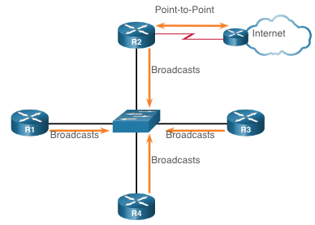
Multiaccess OSPF Networks OPSF Network Types
Another type of network that uses OSPF is the multiaccess OSPF network. Multiaccess OSPF networks are unique in that one router controls the distribution of LSAs.
The router that is elected for this role should be determined by the network administrator through proper configuration.
Notes:
2 - Single-Area OSPFv2 Configuration
2.3 - Multiaccess OSPF Networks 2.3.1 - OPSF Network Types

Slide 5
Multiaccess OSPF Networks OPSF Designated Router
In multiaccess networks, OSPF elects a DR and BDR. The DR is responsible for collecting and distributing LSAs sent and received. The DR uses the multicast IPv4 address 224.0.0.5 which is meant for all OSPF routers.
A BDR is also elected in case the DR fails. The BDR listens passively and maintains a relationship with all the routers. If the DR stops producing Hello packets, the BDR promotes itself and assumes the role of DR.
All other routers become a DROTHER (a router that is neither the DR nor the BDR). DROTHERs use the multiaccess address 224.0.0.6 (all designated routers) to send OSPF packets to the DR and BDR. Only the DR and BDR listen for 224.0.0.6.
Notes:
2 - Single-Area OSPFv2 Configuration
2.3 - Multiaccess OSPF Networks 2.3.2 - OPSF Designated Router

Slide 6
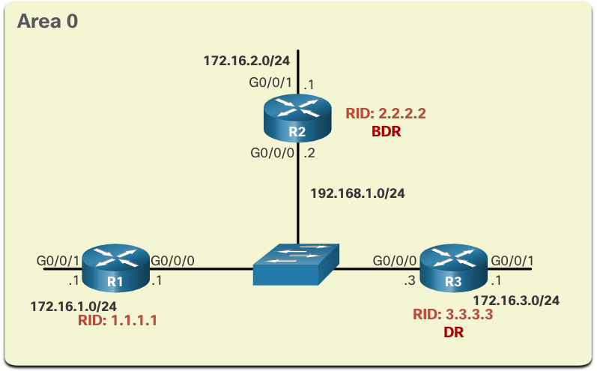
Multiaccess OSPF Networks OPSF Multiaccess Reference Topology
In the multiaccess topology shown in the figure, there are three routers interconnected over a common Ethernet multiaccess network, 192.168.1.0/24.
Because the routers are connected over a common multiaccess network, OSPF has automatically elected a DR and BDR. R3 has been elected as the DR because its router ID is 3.3.3.3, which is the highest in this network. R2 is the BDR because it has the second highest router ID in the network.
Notes:
2 - Single-Area OSPFv2 Configuration
2.3 - Multiaccess OSPF Networks 2.3.3 - OSP Multiaccess Reference Topology

Slide 7
Multiaccess OSPF Networks Verify OSPF Router Roles
To verify the roles of the OSPFv2 router, use the show ip ospf interface command.
The output generated by R1 confirms that the following:
R1 is not the DR or BDR, but is a DROTHER with a default priority of 1. (Line 7)
The DR is R3 with router ID 3.3.3.3 at IPv4 address 192.168.1.3, while the BDR is R2 with router ID 2.2.2.2 at IPv4 address 192.168.1.2. (Lines 8 and 9)
R1 has two adjacencies: one with the BDR and one with the DR. (Lines 20-22)
R1# show ip ospf interface GigabitEthernet 0/0/0
GigabitEthernet0/0/0 is up, line protocol is up
Internet Address 192.168.1.1/24, Area 0, Attached via Interface Enable
Process ID 10, Router ID 1.1.1.1, Network Type BROADCAST, Cost: 1
(output omitted)
Transmit Delay is 1 sec, State DROTHER, Priority 1
Designated Router (ID) 3.3.3.3, Interface address 192.168.1.3
Backup Designated router (ID) 2.2.2.2, Interface address 192.168.1.2
(output omitted)
Neighbor Count is 2, Adjacent neighbor count is 2
Adjacent with neighbor 2.2.2.2 (Backup Designated Router)
Adjacent with neighbor 3.3.3.3 (Designated Router)
Suppress hello for 0 neighbor(s)
R1#
Notes:
2 - Single-Area OSPFv2 Configuration
2.3 - Multiaccess OSPF Networks 2.3.4 - Verify OSPF Router Roles

Slide 8
Multiaccess OSPF Networks Verify OSPF Router Roles (Cont.)
The output generated by R2 confirms that:
R2 is the BDR with a default priority of 1. (Line 7)
The DR is R3 with router ID 3.3.3.3 at IPv4 address 192.168.1.3, while the BDR is R2 with router ID 2.2.2.2 at IPv4 address 192.168.1.2. (Lines 8 and 9)
R2 has two adjacencies; one with a neighbor with router ID 1.1.1.1 (R1) and the other with the DR. (Lines 20-22)
R2# show ip ospf interface GigabitEthernet 0/0/0
GigabitEthernet0/0/0 is up, line protocol is up
Internet Address 192.168.1.2/24, Area 0, Attached via Interface Enable
Process ID 10, Router ID 2.2.2.2, Network Type BROADCAST, Cost: 1
(output omitted)
Transmit Delay is 1 sec, State BDR, Priority 1
Designated Router (ID) 3.3.3.3, Interface address 192.168.1.3
Backup Designated Router (ID) 2.2.2.2, Interface address 192.168.1.2
(output omitted)
Neighbor Count is 2, Adjacent neighbor count is 2
Adjacent with neighbor 1.1.1.1
Adjacent with neighbor 3.3.3.3 (Designated Router)
Suppress hello for 0 neighbor(s)
R2#
Notes:
2 - Single-Area OSPFv2 Configuration
2.3 - Multiaccess OSPF Networks 2.3.4 - Verify OSPF Router Roles (Cont.)

Slide 9
Multiaccess OSPF Networks Verify OSPF Router Roles (Cont.)
The output generated by R3 confirms that:
R3 is the DR with a default priority of 1. (Line 7)
The DR is R3 with router ID 3.3.3.3 at IPv4 address 192.168.1.3, while the BDR is R2 with router ID 2.2.2.2 at IPv4 address 192.168.1.2. (Lines 8 and 9)
R3 has two adjacencies: one with a neighbor with router ID 1.1.1.1 (R1) and the other with the BDR. (Lines 20-22)
R3# show ip ospf interface GigabitEthernet 0/0/0
GigabitEthernet0/0/0 is up, line protocol is up
Internet Address 192.168.1.3/24, Area 0, Attached via Interface Enable
Process ID 10, Router ID 3.3.3.3, Network Type BROADCAST, Cost: 1
(output omitted)
Transmit Delay is 1 sec, State DR, Priority 1
Designated Router (ID) 3.3.3.3, Interface address 192.168.1.3
Backup Designated Router (ID) 2.2.2.2, Interface address 192.168.1.2
(output omitted)
Neighbor Count is 2, Adjacent neighbor count is 2
Adjacent with neighbor 1.1.1.1
Adjacent with neighbor 2.2.2.2 (Backup Designated Router)
Suppress hello for 0 neighbor(s)
R3#
Notes:
2 - Single-Area OSPFv2 Configuration
2.3 - Multiaccess OSPF Networks 2.3.4 - Verify OSPF Router Roles (Cont.)

Slide 10
Multiaccess OSPF Networks Verify DR/BDR Adjacencies
To verify the OSPFv2 adjacencies, use the show ip ospf neighbor command. The state of neighbors in multiaccess networks can be as follows:
FULL/DROTHER - This is a DR or BDR router that is fully adjacent with a non-DR or BDR router. These two neighbors can exchange Hello packets, updates, queries, replies, and acknowledgments.
FULL/DR - The router is fully adjacent with the indicated DR neighbor. These two neighbors can exchange Hello packets, updates, queries, replies, and acknowledgments.
FULL/BDR - The router is fully adjacent with the indicated BDR neighbor. These two neighbors can exchange Hello packets, updates, queries, replies, and acknowledgments.
2-WAY/DROTHER - The non-DR or BDR router has a neighbor relationship with another non-DR or BDR router. These two neighbors exchange Hello packets.
The normal state for an OSPF router is usually FULL. If a router is stuck in another state, it is an indication that there are problems in forming adjacencies. The only exception to this is the 2-WAY state, which is normal in a multiaccess broadcast network.
Notes:
2 - Single-Area OSPFv2 Configuration
2.3 - Multiaccess OSPF Networks 2.3.5 - Verify DR/BDR Adjacencies

Slide 11
Multiaccess OSPF Networks Verify DR/BDR Adjacencies (Cont.)
The output generated by R2 confirms that R2 has adjacencies with the following routers:
R1 with router ID 1.1.1.1 is in a Full state and R1 is neither the DR nor BDR.
R3 with router ID 3.3.3.3 is in a Full state and the role of R3 is DR.
R2# show ip ospf neighbor
Neighbor ID Pri State Dead Time Address Interface
1.1.1.1 1 FULL/DROTHER 00:00:31 192.168.1.1 GigabitEthernet0/0/0
3.3.3.3 1 FULL/DR 00:00:34 192.168.1.3 GigabitEthernet0/0/0 R2#
Notes:
2 - Single-Area OSPFv2 Configuration
2.3 - Multiaccess OSPF Networks 2.3.5 - Verify DR/BDR Adjacencies (Cont.)

Slide 12
Multiaccess OSPF Networks Default DR/BDR Election Process
The OSPF DR and BDR election is based on the following criteria, in sequential order:
The routers in the network elect the router with the highest interface priority as the DR. The router with the second highest interface priority is becomes the BDR.
The priority can be configured to be any number between 0 – 255.
If the interface priority value is set to 0, that interface cannot be elected as DR nor BDR.
The default priority of multiaccess broadcast interfaces is 1.
If the interface priorities are equal, then the router with the highest router ID is elected the DR. The router with the second highest router ID is the BDR.
The election process takes place when the first router with an OSPF-enabled interface is active on the network. If all of the routers on the network have not finished booting, it is possible that a router with a lower router ID becomes the DR.
The addition of a new router does not initiate a new election process.
Notes:
2 - Single-Area OSPFv2 Configuration
2.3 - Multiaccess OSPF Networks 2.3.6 - Default DR/BDR Election Process

Slide 13
Multiaccess OSPF Networks DR Failure and Recovery
After the DR is elected, it remains the DR until one of the following events occurs:
The DR fails.
The OSPF process on the DR fails or is stopped.
The multiaccess interface on the DR fails or is shutdown.
If the DR fails, the BDR is automatically promoted to DR. This is the case even if another DROTHER with a higher priority or router ID is added to the network after the initial DR/BDR election. However, after a BDR is promoted to DR, a new BDR election occurs and the DROTHER with the highest priority or router ID is elected as the new BDR.
Notes:
2 - Single-Area OSPFv2 Configuration
2.3 - Multiaccess OSPF Networks 2.3.7 - DR Failure and Recovery

Slide 14
Multiaccess OSPF Networks The ip ospf priority Command
If the interface priorities are equal on all routers, the router with the highest router ID is elected the DR.
Instead of relying on the router ID, it is better to control the election by setting interface priorities. This also allows a router to be the DR in one network and a DROTHER in another.
To set the priority of an interface, use the command ip ospf priority value, where value is 0 to 255.
A value of 0 does not become a DR or a BDR.
A value of 1 to 255 on the interface makes it more likely that the router becomes the DR or the BDR.
Notes:
2 - Single-Area OSPFv2 Configuration
2.3 - Multiaccess OSPF Networks 2.3.8 - The ip ospf priority Command

Slide 15
Multiaccess OSPF Networks Configure OSPF Priority
The example shows the commands being used to change the R1 G0/0/0 interface priority from 1 to 255 and then reset the OSPF process.
R1(config)# interface GigabitEthernet 0/0/0
R1(config-if)# ip ospf priority 255
R1(config-if)# end
R1# clear ip ospf process
Reset ALL OSPF processes? [no]: y
R1# *Jun 5 03:47:41.563: %OSPF-5-ADJCHG: Process 10, Nbr 2.2.2.2 on GigabitEthernet0/0/0 from FULL to DOWN, Neighbor Down: Interface down or detached
Notes:
2 - Single-Area OSPFv2 Configuration
2.3 - Multiaccess OSPF Networks 2.3.9 - Configure OSPF Priority
2.3.10 - Syntax Checker - Configure OSPF Priority

Slide 16
10.2 Advanced Single-Area OSPF Configurations
Notes:
10 – OSPF Tuning and Troubleshooting
10.1 – Advanced Single-Area OSPF Configurations

Slide 17
Default Route Propagation Propagate a Default Static Route in OSPFv2
To propagate a default route, the edge router must be configured with the following:
A default static route using the ip route 0.0.0.0 0.0.0.0 [next-hop-address | exit-intf] command.
The default-information originate router configuration command. This instructs R2 to be the source of the default route information and propagate the default static route in OSPF updates.
In the example, R2 is configured with a loopback to simulate a connection to the internet. A default route is configured and propagated to all other OSPF routers in the routing domain.
Note: When configuring static routes, best practice is to use the next-hop IP address. However, when simulating a connection to the internet, there is no next-hop IP address. Therefore, we use the exit-intf argument.
R2(config)# interface lo1
R2(config-if)# ip address 64.100.0.1 255.255.255.252
R2(config-if)# exit
R2(config)# ip route 0.0.0.0 0.0.0.0 loopback 1
%Default route without gateway, if not a point-to-point interface, may impact performance
R2(config)# router ospf 10
R2(config-router)# default-information originate
R2(config-router)# end
R2#
Notes:
2 - Single-Area OSPFv2 Configuration
2.5 - Default Route Propagation
2.5.1 - Propagate a Default Static Route in OSPFv2

Slide 18
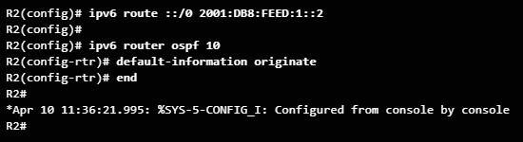
Advanced Single-Area OSPF Configurations Propagating a Default Static Route in OSPFv3
To propagate a default route, the edge router (R2) must be configured with:
A default static route using the ipv6 route ::/0 {ipv6-address | exit-intf} command.
The default-information originate router configuration mode command.
Notes:
10.1 - Advanced Single-Area OSPF Configurations
10.1.2 – Default Route Propagation
10.1.2.3 – Propagating a Default Static Route in OSPFv3

Slide 19
Default Route Propagation Verify the Propagated Default Route
You can verify the default route settings on R2 using the show ip route command. You can also verify that R1 and R3 received a default route.
Notice that the route source on R1 is O*E2, signifying that it was learned using OSPFv2. The asterisk identifies this as a good candidate for the default route. The E2 designation identifies that it is an external route. The meaning of E1 and E2 is beyond the scope of this module.
R2# show ip route | begin Gateway
Gateway of last resort is 0.0.0.0 to network 0.0.0.0
S* 0.0.0.0/0 is directly connected, Loopback1
10.0.0.0/8 is variably subnetted, 9 subnets, 3 masks
(output omitted)
R1# show ip route | begin Gateway
Gateway of last resort is 10.1.1.6 to network 0.0.0.0
O*E2 0.0.0.0/0 [110/1] via 10.1.1.6, 00:11:08, GigabitEthernet0/0/0
10.0.0.0/8 is variably subnetted, 9 subnets, 3 masks
(output omitted)
Notes:
2 - Single-Area OSPFv2 Configuration
2.5 - Default Route Propagation
2.5.2 - Verify the Propagated Default Route

Slide 20
Modify Single-Area OSPFv2 Hello Packet Intervals
OSPFv2 Hello packets are transmitted to multicast address 224.0.0.5 (all OSPF routers) every 10 seconds. This is the default timer value on multiaccess and point-to-point networks.
Note: Hello packets are not sent on interfaces set to passive by the passive-interface command.
The Dead interval is the period that the router waits to receive a Hello packet before declaring the neighbor down. If the Dead interval expires before the routers receive a Hello packet, OSPF removes that neighbor from its link-state database (LSDB). The router floods the LSDB with information about the down neighbor out all OSPF-enabled interfaces. Cisco uses a default of 4 times the Hello interval. This is 40 seconds on multiaccess and point-to-point networks.
Notes:
2 - Single-Area OSPFv2 Configuration
2.4 - Modify Single-Area OSPFv2
2.4.7 - Hello Packet Intervals

Slide 21
Modify Single-Area OSPFv2 Verify Hello and Dead Intervals
The OSPF Hello and Dead intervals are configurable on a per-interface basis.
The OSPF intervals must match or a neighbor adjacency does not occur.
To verify the currently configured OSPFv2 interface intervals, use the show ip ospf interface command. The Gigabit Ethernet 0/0/0 Hello and Dead intervals are set to the default 10 seconds and 40 seconds respectively.
R1# show ip ospf interface g0/0/0
GigabitEthernet0/0/0 is up, line protocol is up
Internet Address 10.1.1.5/30, Area 0, Attached via Interface Enable
Process ID 10, Router ID 1.1.1.1, Network Type POINT_TO_POINT, Cost: 10
Topology-MTID Cost Disabled Shutdown Topology Name
0 10 no no Base
Enabled by interface config, including secondary ip addresses
Transmit Delay is 1 sec, State POINT_TO_POINT
Timer intervals configured, Hello 10, Dead 40, Wait 40, Retransmit 5
oob-resync timeout 40
(output omitted)
Notes:
2 - Single-Area OSPFv2 Configuration
2.4 - Modify Single-Area OSPFv2
2.4.8 - Verify Hello and Dead Intervals

Slide 22
Modify Single-Area OSPFv2 Verify Hello and Dead Intervals (Cont.)
Use the show ip ospf neighbor command to see the Dead Time counting down from 40 seconds. By default, this value is refreshed every 10 seconds when R1 receives a Hello from the neighbor.
R1# show ip ospf neighbor
Neighbor ID Pri State Dead Time Address Interface
3.3.3.3 0 FULL/ - 00:00:35 10.1.1.13 GigabitEthernet0/0/1
2.2.2.2 0 FULL/ - 00:00:31 10.1.1.6 GigabitEthernet0/0/0
R1#
Notes:
2 - Single-Area OSPFv2 Configuration
2.4 - Modify Single-Area OSPFv2
2.4.8 - Verify Hello and Dead Intervals (Cont.)

Slide 23
Modify Single-Area OSPFv2 Modify OSPFv2 Intervals
It may be desirable to change the OSPF timers so that routers detect network failures in less time. Doing this increases traffic, but sometimes the need for quick convergence is more important than the extra traffic it creates.
Note: The default Hello and Dead intervals are based on best practices and should only be altered in rare situations.
OSPFv2 Hello and Dead intervals can be modified manually using the following interface configuration mode commands:
Router(config-if)# ip ospf hello-interval seconds
Router(config-if)# ip ospf dead-interval seconds
Use the no ip ospf hello-interval and no ip ospf dead-interval commands to reset the intervals to their default.
Notes:
2 - Single-Area OSPFv2 Configuration
2.4 - Modify Single-Area OSPFv2
2.4.9 - Modify OSPFv2 Intervals

Slide 24
Modify Single-Area OSPFv2 Modify OSPFv2 Intervals (Cont.)
In the example, the Hello interval for the link between R1 and R2 is changed to 5 seconds. The Cisco IOS automatically modifies the Dead interval to four times the Hello interval. However, you can document the new Dead interval in the configuration by manually setting it to 20 seconds, as shown.
When the Dead Timer on R1 expires, R1 and R2 lose adjacency. R1 and R2 must be configured with the same Hello interval. Use the show ip ospf neighbor command on R1 to verify the neighbor adjacencies.
R1(config)# interface g0/0/0
R1(config-if)# ip ospf hello-interval 5
R1(config-if)# ip ospf dead-interval 20
R1(config-if)#
*Jun 7 04:56:07.571: %OSPF-5-ADJCHG: Process 10, Nbr 2.2.2.2 on GigabitEthernet0/0/0 from FULL to DOWN, Neighbor Down: Dead timer expired
R1(config-if)# end
R1# show ip ospf neighbor
Neighbor ID Pri State Dead Time Address Interface
3.3.3.3 0 FULL/ - 00:00:37 10.1.1.13 GigabitEthernet0/0/1
R1#
Notes:
2 - Single-Area OSPFv2 Configuration
2.4 - Modify Single-Area OSPFv2
2.4.9 - Modify OSPFv2 Intervals (Cont.)
2.4.10 - Syntax Checker - Modifying Hello and Dead Intervals on R3

Slide 25
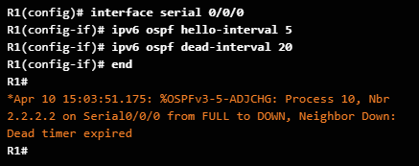
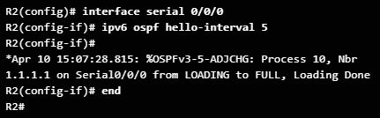
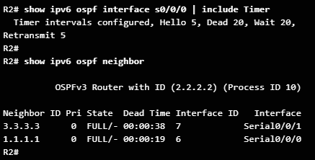
Advanced Single-Area OSPF Configurations Modifying OSPFv3 Intervals
OSPFv3 Hello and Dead intervals can be modified using the interface configuration mode commands:
ipv6 ospf hello-interval seconds
ipv6 ospf dead-interval seconds
Use the no ipv6 ospf hello-interval and no ipv6 ospf dead-interval interface configuration commands to reset the intervals to their default.
Notes:
10.1 - Advanced Single-Area OSPF Configurations
10.1.3 – Fine-tuning OSPF Interfaces
10.1.3.3 – Modifying OSPFv3 Intervals

Slide 26
Point-to-Point OSPF Networks Passive Interface
By default, OSPF messages are forwarded out all OSPF-enabled interfaces. However, these messages only need to be sent out interfaces that are connecting to other OSPF-enabled routers.
Sending out unneeded messages on a LAN affects the network in three ways:
Inefficient Use of Bandwidth - Available bandwidth is consumed transporting unnecessary messages.
Inefficient Use of Resources - All devices on the LAN must process and eventually discard the message.
Increased Security Risk - Without additional OSPF security configurations, OSPF messages can be intercepted with packet sniffing software. Routing updates can be modified and sent back to the router, corrupting the routing table with false metrics that misdirect traffic.
Notes:
2 - Single-Area OSPFv2 Configuration
2.2 - Point-to-Point OSPF Networks
2.2.8 - Passive Interface

Slide 27
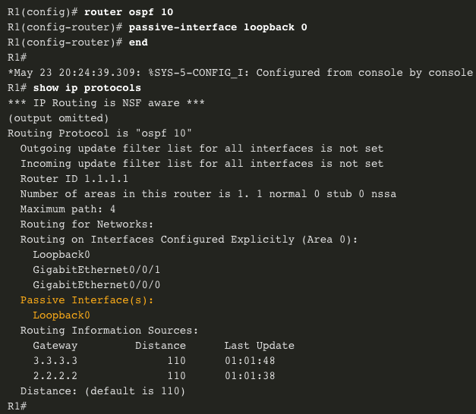
Point-to-Point OSPF Networks Configure Passive Interfaces
Use the passive-interface router configuration mode command to prevent the transmission of routing messages through a router interface, but still allow that network to be advertised to other routers.
The show ip protocols command is then used to verify that the interface is listed as passive.
Notes:
2 - Single-Area OSPFv2 Configuration
2.2 - Point-to-Point OSPF Networks
2.2.9 - Configure Passive Interfaces
2.2.10 - Syntax Checker - Configure R2 and R3 Passive Interfaces

Slide 28
10.3 Troubleshooting Single-Area OSPF Implementations
Notes:
10 – OSPF Tuning and Troubleshooting
10.2 – Troubleshooting Single-Area OSPF Implementations

Slide 29
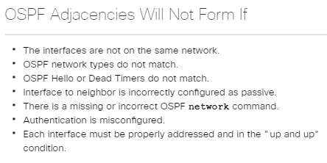
Troubleshooting Single-Area OSPF Implementations Components of Troubleshooting Single-Area OSPF
OSPF is a popular routing protocol in large enterprise networks.
Troubleshooting problems related to the exchange of routing information is one of the most essential skills for a network administrator.
Notes:
10.2 - Troubleshooting Single-Area OSPF Implementations
10.2.1 – Components of Troubleshooting Single-Area OSPF
10.2.1.1 – Overview

Slide 30
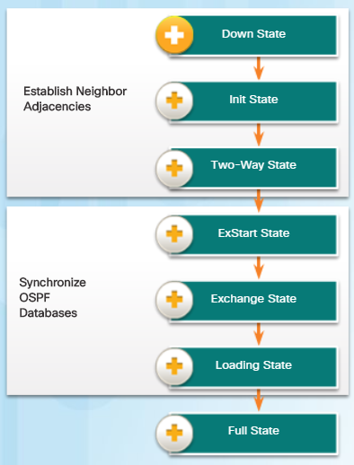
Troubleshooting Single-Area OSPF Implementations OSPF States
To troubleshoot OSPF, it is important to understand how OSPF routers traverse different OSPF states when adjacencies are being established.
When troubleshooting OSPF neighbors, be aware that the FULL or 2WAY states are normal.
All other states are transitory and the router should not remain in those states for extended periods of time.
Notes:
10.2 - Troubleshooting Single-Area OSPF Implementations
10.2.1 – Components of Troubleshooting Single-Area OSPF
10.2.1.2 – OSPF States

Slide 31
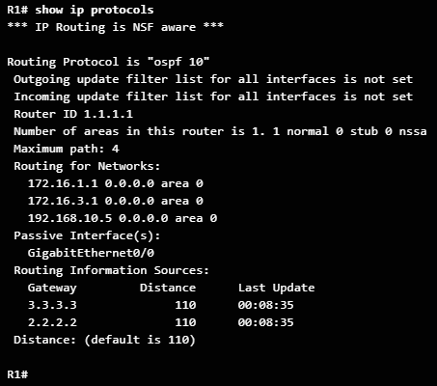
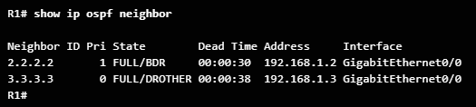
Troubleshooting Single-Area OSPF Implementations OSPF Troubleshooting Commands
Common OSPFv2 troubleshooting commands include:
show ip protocols - Used to verify vital OSPFv2 configuration information.
show ip ospf neighbor - Used to verify that the router has formed an OSPFv2 adjacency with its neighboring routers.
show ip ospf interface - Used to display the OSPFv2 parameters configured on an interface.
show ip ospf - Used to examine the OSPFv2 process ID and router ID.
show ip route ospf - Used to display only the OSPFv2 learned routes in the IPv4 routing table. T
clear ip ospf [process-id] process - Used to reset the OSPFv2 neighbor adjacencies
Note: For the equivalent OSPFv3 command, simply substitute ip with ipv6.
Notes:
10.2 - Troubleshooting Single-Area OSPF Implementations
10.2.1 – Components of Troubleshooting Single-Area OSPF
10.2.1.3 – OSPF Troubleshooting Commands

Slide 32
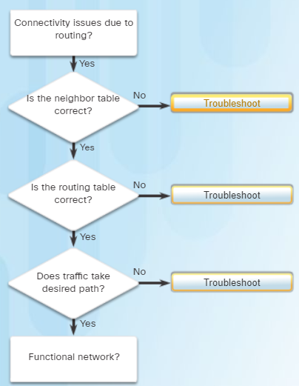
Troubleshooting Single-Area OSPF Implementations Components of Troubleshooting OSPF
OSPF problems usually relate to:
Neighbor adjacencies
Missing routes
Path selection
Use:
show ip ospf neighbor
show ip interface brief
show ip ospf interface
Use:
show ip protocols
show ip route ospf
Use:
show ip route ospf
show ip ospf interface
Note: For the equivalent OSPFv3 command, simply substitute ip with ipv6.
Notes:
10.2 - Troubleshooting Single-Area OSPF Implementations
10.2.1 – Components of Troubleshooting Single-Area OSPF
10.2.1.4 – Components of Troubleshooting OSPF

Slide 33
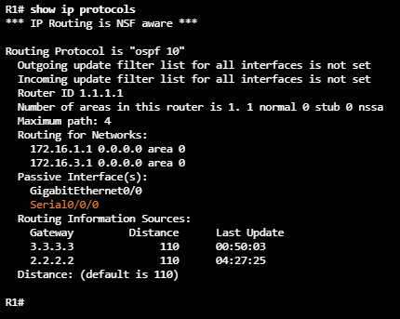
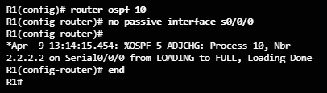
Troubleshooting Single-Area OSPF Implementations Troubleshooting Neighbor Issues
When troubleshooting neighbor issues:
Verify the routing table using the show ip route ospf command.
Verify that interfaces are active using the show ip interface brief command.
Verify active OSPF interfaces using the show ip ospf interface command.
Verify the OSPFv2 settings using the show ip protocols command.
Recall that the passive-interface command stops both outgoing and incoming routing updates and for that reason, routers will not become neighbors.
Notes:
10.2 - Troubleshooting Single-Area OSPF Implementations
10.2.2 –Troubleshooting Single-Area OSPFv2 Routing Issues
10.2.2.1 – Troubleshooting Neighbor Issues

Slide 34
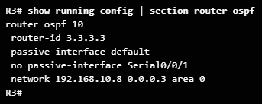
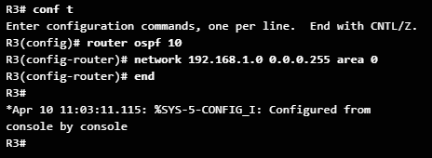
Troubleshooting Single-Area OSPF Implementations Troubleshooting OSPFv2 Routing Table Issues
When troubleshooting routing table issues:
Verify the routing table using the show ip route ospf command.
Verify the OSPFv2 settings using the show ip protocols command.
Verify the OSPF configuration using the show running-config | section router ospf command.
Notes:
10.2 - Troubleshooting Single-Area OSPF Implementations
10.2.2 –Troubleshooting Single-Area OSPFv2 Routing Issues
10.2.2.2 – Troubleshooting OSPFv2 Routing Table Issues

Slide 35
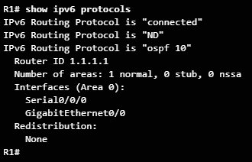

Troubleshooting Single-Area OSPF Implementations OSPFv3 Troubleshooting Commands
Common OSPFv3 troubleshooting commands include:
show ipv6 protocols - Used to verify vital OSPFv3 configuration information.
show ipv6 ospf neighbor - Used to verify that the router has formed an OSPFv3 adjacency with its neighboring routers.
show ipv6 ospf interface - Used to display the OSPFv3 parameters configured on an interface.
show ipv6 ospf - Used to examine the OSPFv3 process ID and router ID.
show ipv6 route ospf - Used to display only the OSPFv3 learned routes in the IPv4 routing table. T
clear ipv6 ospf [process-id] process - Used to reset the OSPFv3 neighbor adjacencies
.
Notes:
10.2 - Troubleshooting Single-Area OSPF Implementations
10.2.3 –Troubleshooting Single-Area OSPFv3 Routing Issues
10.2.3.1 – OSPFv3 Troubleshooting Commands

Slide 36
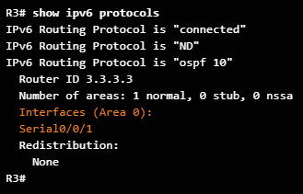
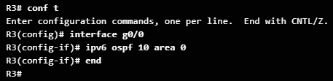
Troubleshooting Single-Area OSPF Implementations Troubleshooting OSPFv3
In this example, R1 is not receiving the R3 LAN OSPFv3 route (2001:DB8:CAFE:3::/64).
Verifying the R3 routing protocol settings reveals that R3 is not enabled on the G0/0 R3 interface.
Enable OSPFv3 on the R3 Gigabit Ethernet 0/0 interface.
The R3 LAN is now in the routing table of R1.
Notes:
10.2 - Troubleshooting Single-Area OSPF Implementations
10.2.3 –Troubleshooting Single-Area OSPFv3 Routing Issues
10.2.3.2 – Troubleshooting OSPFv3

Slide 37
Troubleshooting Single-Area OSPF Implementations Multiarea OSPF Troubleshooting Skills
Before you can begin to diagnose and resolve problems related to a multiarea OSPF implementation, you must be able to do the following:
Understand the processes OSPF uses to distribute, store, and select routing information.
Understand how OSPF information flows within and between areas.
Use Cisco IOS commands to gather and interpret the information necessary to troubleshoot OSPF operation.
Notes:
10.2 - Troubleshooting Single-Area OSPF Implementations
10.2.4 –Troubleshooting Multi-Area OSPFv2 and OSPFv3
10.2.4.1 – Multiarea OSPF Troubleshooting Skills

Slide 38
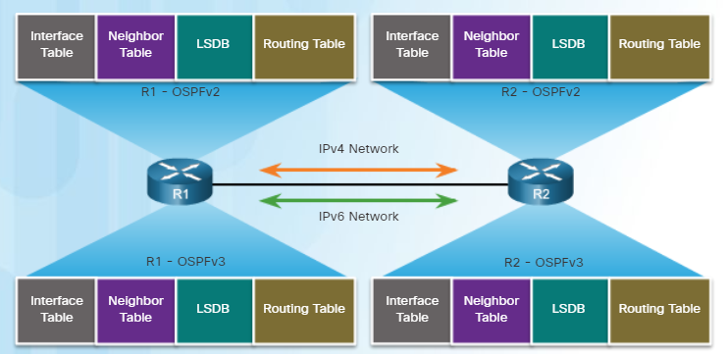
Troubleshooting Single-Area OSPF Implementations Multiarea OSPF Troubleshooting Data Structures
OSPF stores routing information in four main data structures:
OSPF Data Structures | Description
Interface table | Includes a list of all active OSPF interfaces. Type 1 LSAs include the subnets associated with each active interface.
Neighbor table | Used to manage neighbor adjacencies through hello timers and dead timers. Neighbor entries are added and refreshed when a hello is received. Neighbors are removed when dead timer expires.
Link-state database (LSDB) | This is the primary data structure used by OSPF to store network topology information. It includes full topological information about each area that the OSPF router is connected to and any paths that are available to reach other networks.
Routing table | After the SPF algorithm is calculated, the best routes are offered to the routing table
Notes:
10.2 - Troubleshooting Single-Area OSPF Implementations
10.2.4 –Troubleshooting Multi-Area OSPFv2 and OSPFv3
10.2.4.2 – Multiarea OSPF Troubleshooting Data Structures

Slide 39
10.4 Module Summary
Notes:
10 – OSPF Tuning and Troubleshooting
10.3 – Summary

Slide 40
Conclusion Module 10: OSPF Tuning and Troubleshooting
OSPF defines five network types: point-to-point, broadcast multiaccess, nonbroadcast multiaccess, point-to-multipoint, and virtual links.
Multiaccess networks can create two challenges for OSPF regarding the flooding of LSAs: creation of multiple adjacencies and extensive flooding of LSAs. The solution to managing the number of adjacencies and the flooding of LSAs on a multiaccess network is the DR and BDR. If the DR stops producing Hellos, the BDR promotes itself and assumes the role of DR.
The routers in the network elect the router with the highest interface priority as DR. The router with the second highest interface priority is elected the BDR. The higher the priority, the likelier the router will be selected as the DR. If set to 0, the router is not capable of becoming the DR. The default priority of multiaccess broadcast interfaces is 1. Therefore, unless otherwise configured, all routers have an equal priority value and must rely on another tie breaking method during the DR/BDR election. If the interface priorities are equal, then the router with the highest router ID is elected the DR. The router with the second highest router ID is the BDR. The addition of a new router does not initiate a new election process.
Notes:
10.3 – Summary
10.3.1 – Conclusion
10.3.1.3 – Chapter 10: OSPF Tuning and Troubleshooting

Slide 41
Conclusion Module 10: OSPF Tuning and Troubleshooting (Cont.)
To propagate a default route in OSPF, the router must be configured with a default static route and the default-information originate command must be added to the configuration. Verify routes with the show ip route or show ipv6 route command.
To assist OSPF in making the correct path determination, the reference bandwidth must be changed to a higher value to accommodate networks with links faster than 100 Mbps. To adjust the reference bandwidth, use the auto-cost reference-bandwidth Mbps router configuration mode command. To adjust the interface bandwidth, use the bandwidth kilobits interface configuration mode command. The cost can be manually configured on an interface using the ip ospf cost value interface configuration mode command.
The OSPF Hello and Dead intervals must match or a neighbor adjacency does not occur. To modify these intervals, use the following interface commands:
ip ospf hello-interval seconds
ip ospf dead-interval seconds
ipv6 ospf hello-interval seconds
ipv6 ospf dead-interval seconds
Notes:
10.3 – Summary
10.3.1 – Conclusion
10.3.1.3 – Chapter 10: OSPF Tuning and Troubleshooting

Slide 42
Conclusion Module 10: OSPF Tuning and Troubleshooting (Cont.)
When troubleshooting OSPF neighbors, be aware that the FULL or 2WAY states are normal. The following commands summarize OSPFv2 troubleshooting:
show ip protocols
show ip ospf neighbor
show ip ospf interface
show ip ospf
show ip route ospf
clear ip ospf [process-id] process
Troubleshooting OSPFv3 is similar to OSPFv2. The following commands are the equivalent commands used with OSPFv3: show ipv6 protocols, show ipv6 ospf neighbor, show ipv6 ospf interface, show ipv6 ospf, show ipv6 route ospf, and clear ipv6 ospf [process-id] process.
Notes:
10.3 – Summary
10.3.1 – Conclusion
10.3.1.3 – Chapter 10: OSPF Tuning and Troubleshooting

